Slide 1


2020 Annual Report
Bill Crow,
President

Slide 2
2020

Slide 3
2020
How Upside Down?

Slide 4
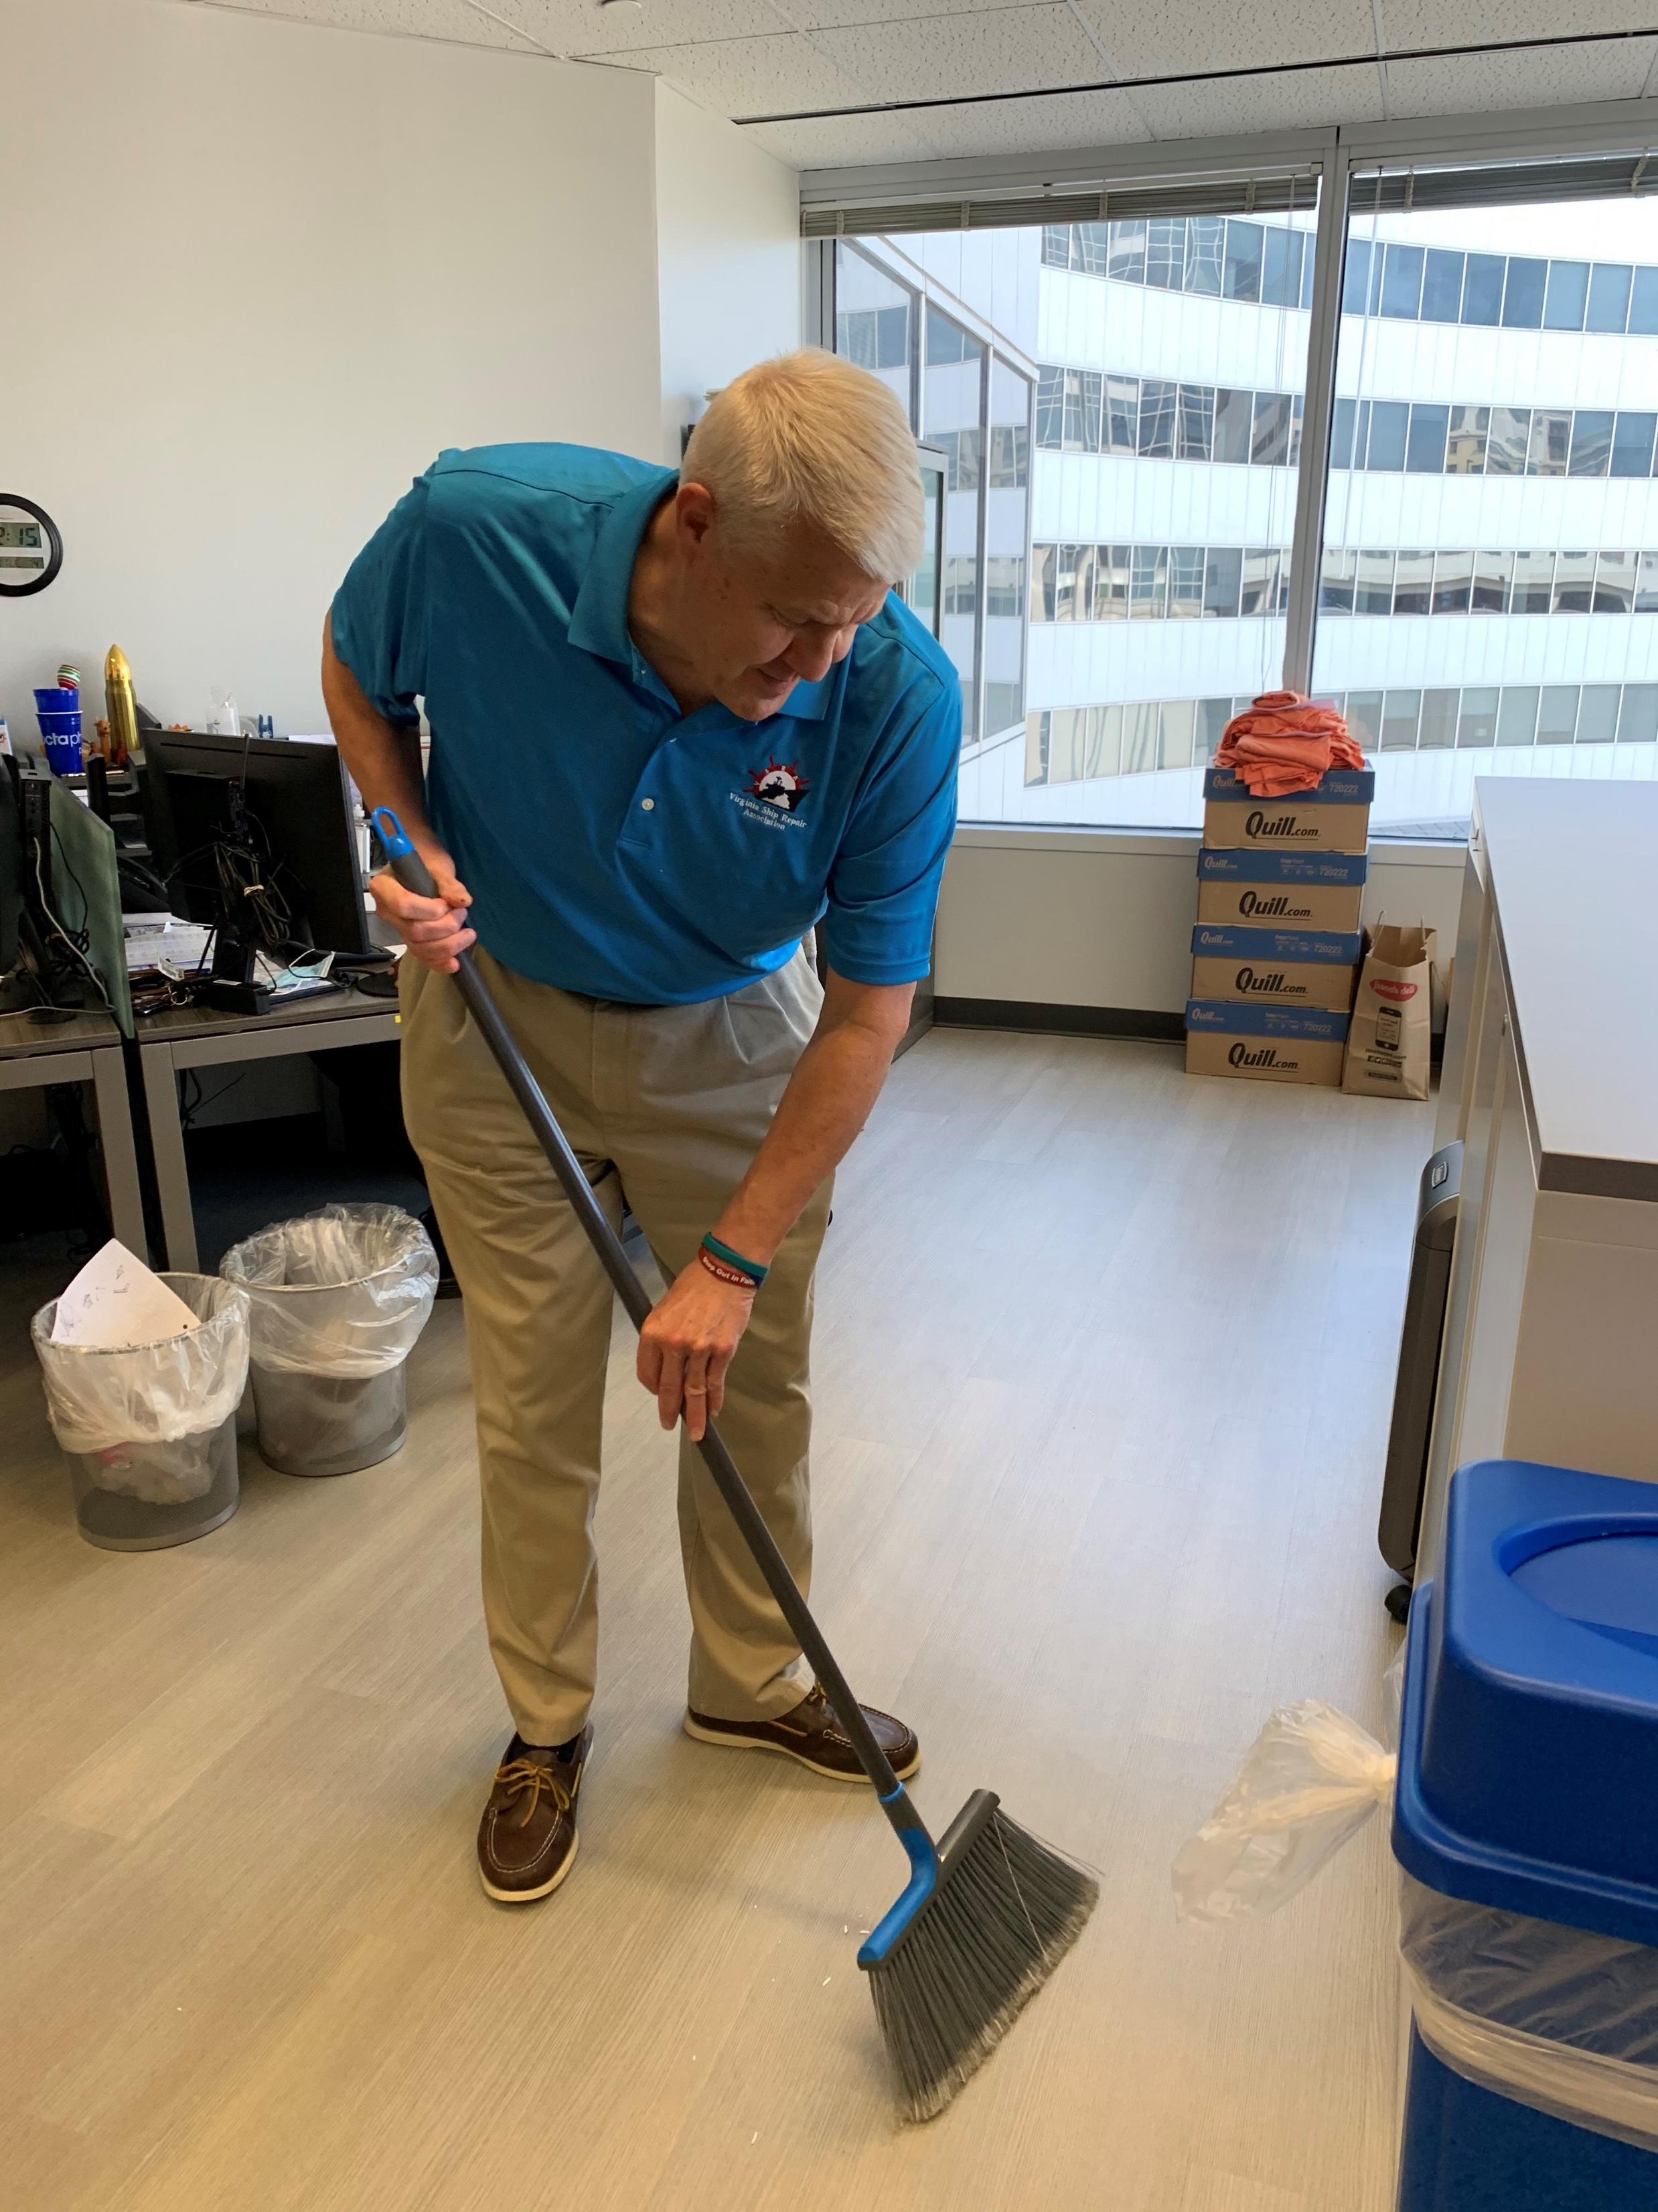
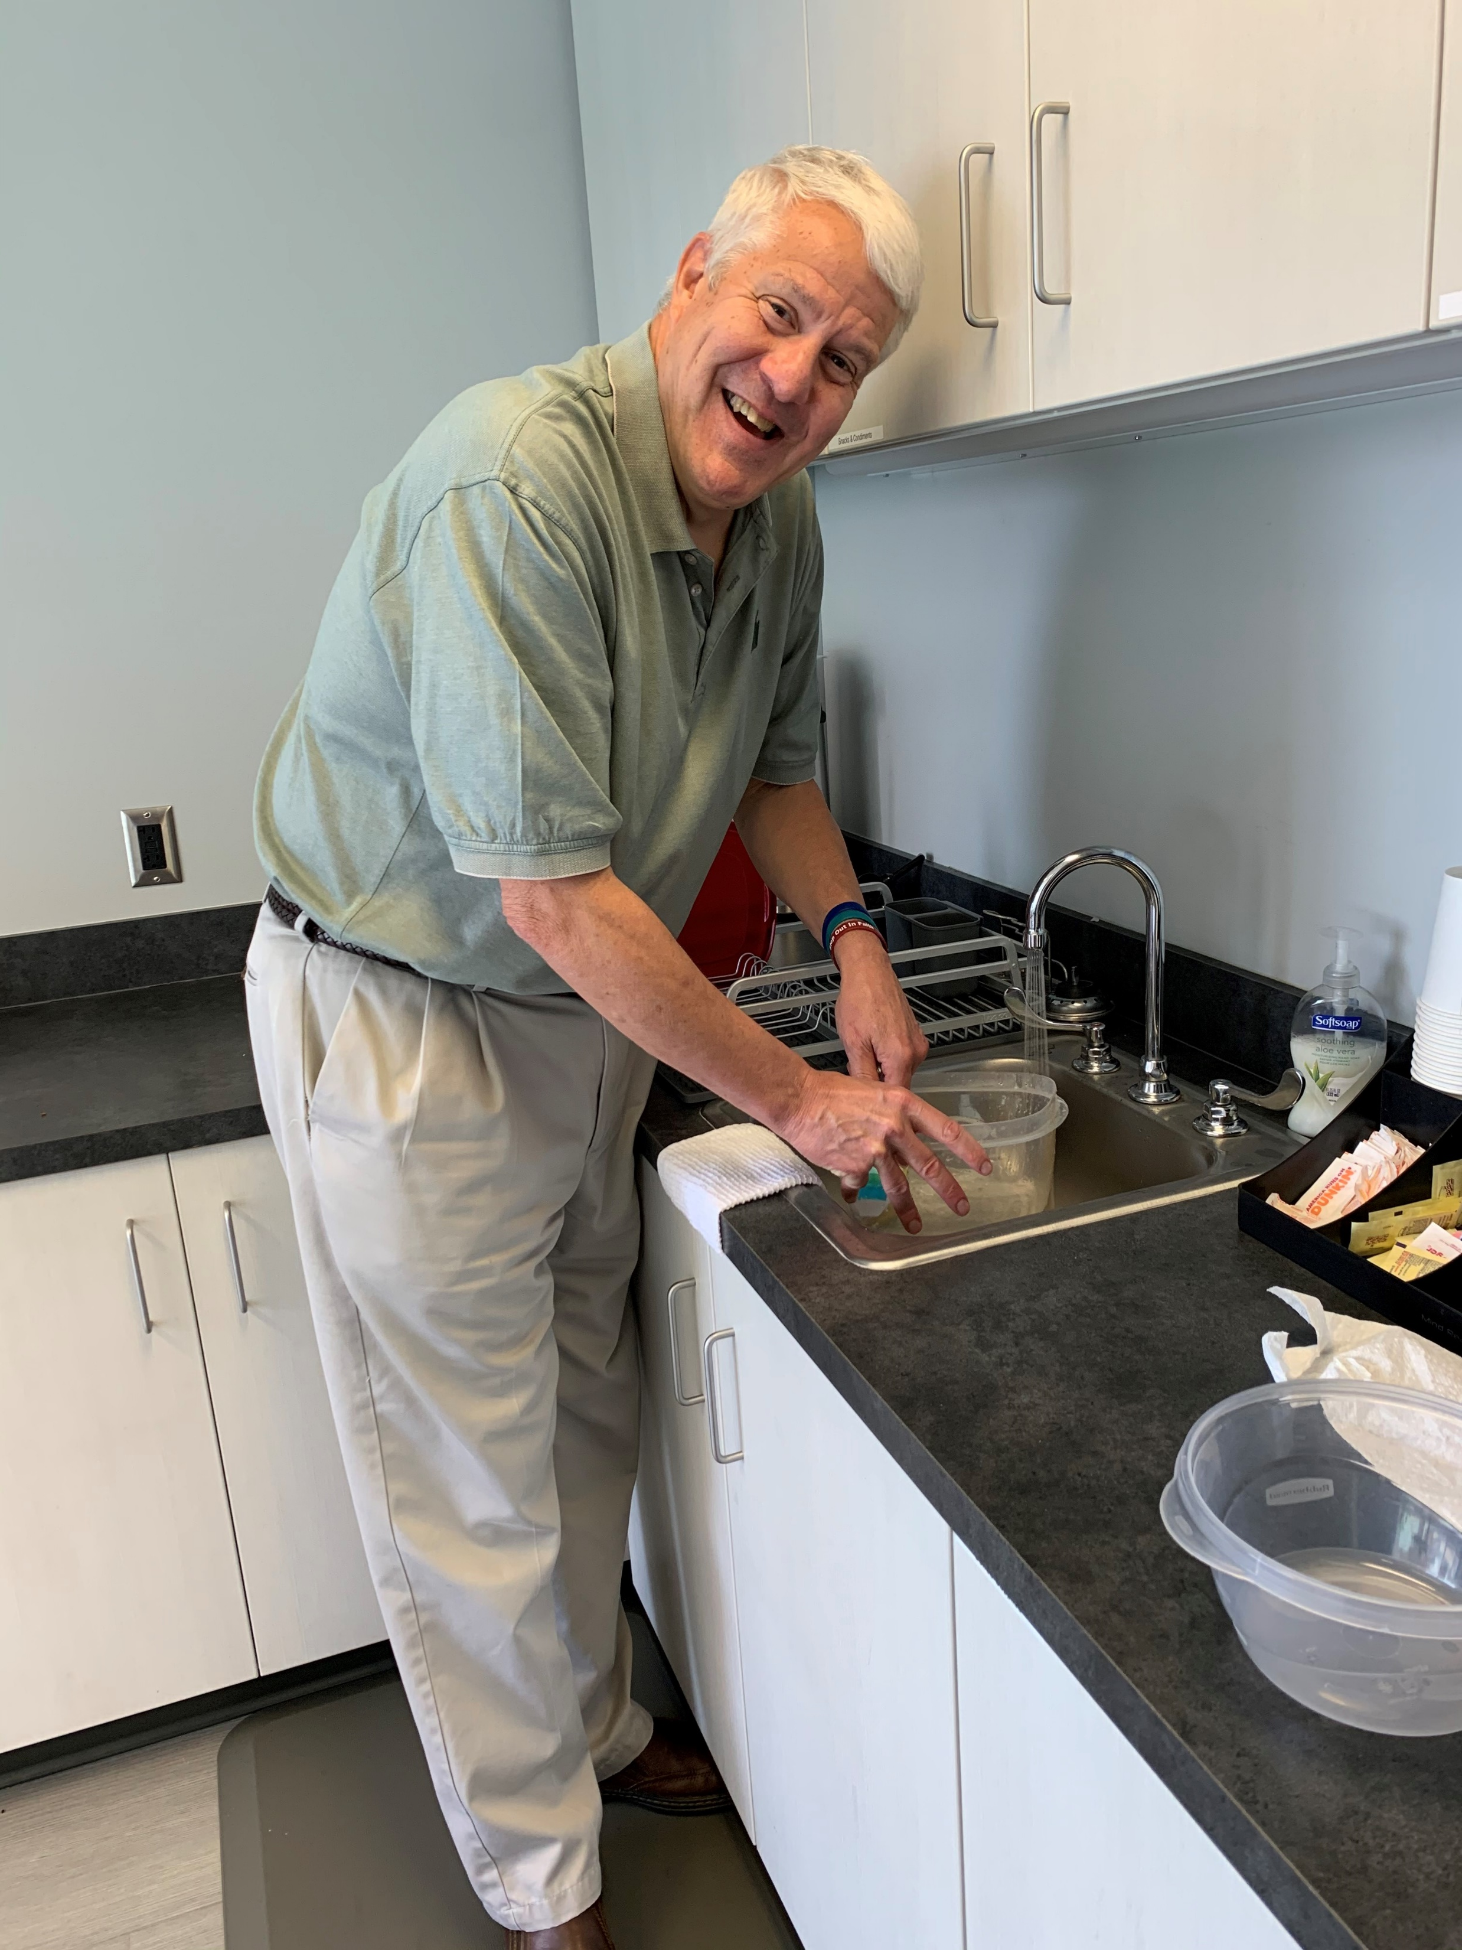
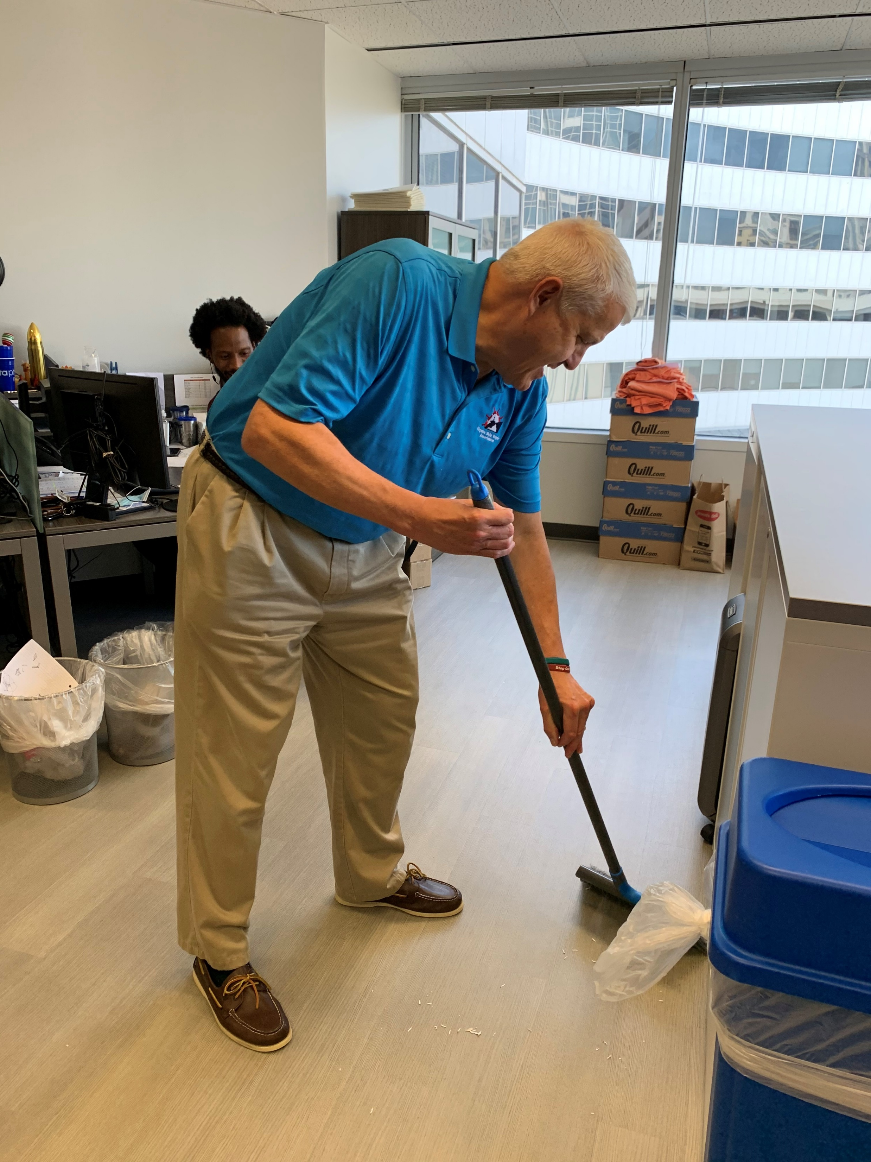
How Upside Down?

Slide 5
2020

Slide 6
2020

Slide 7
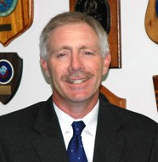
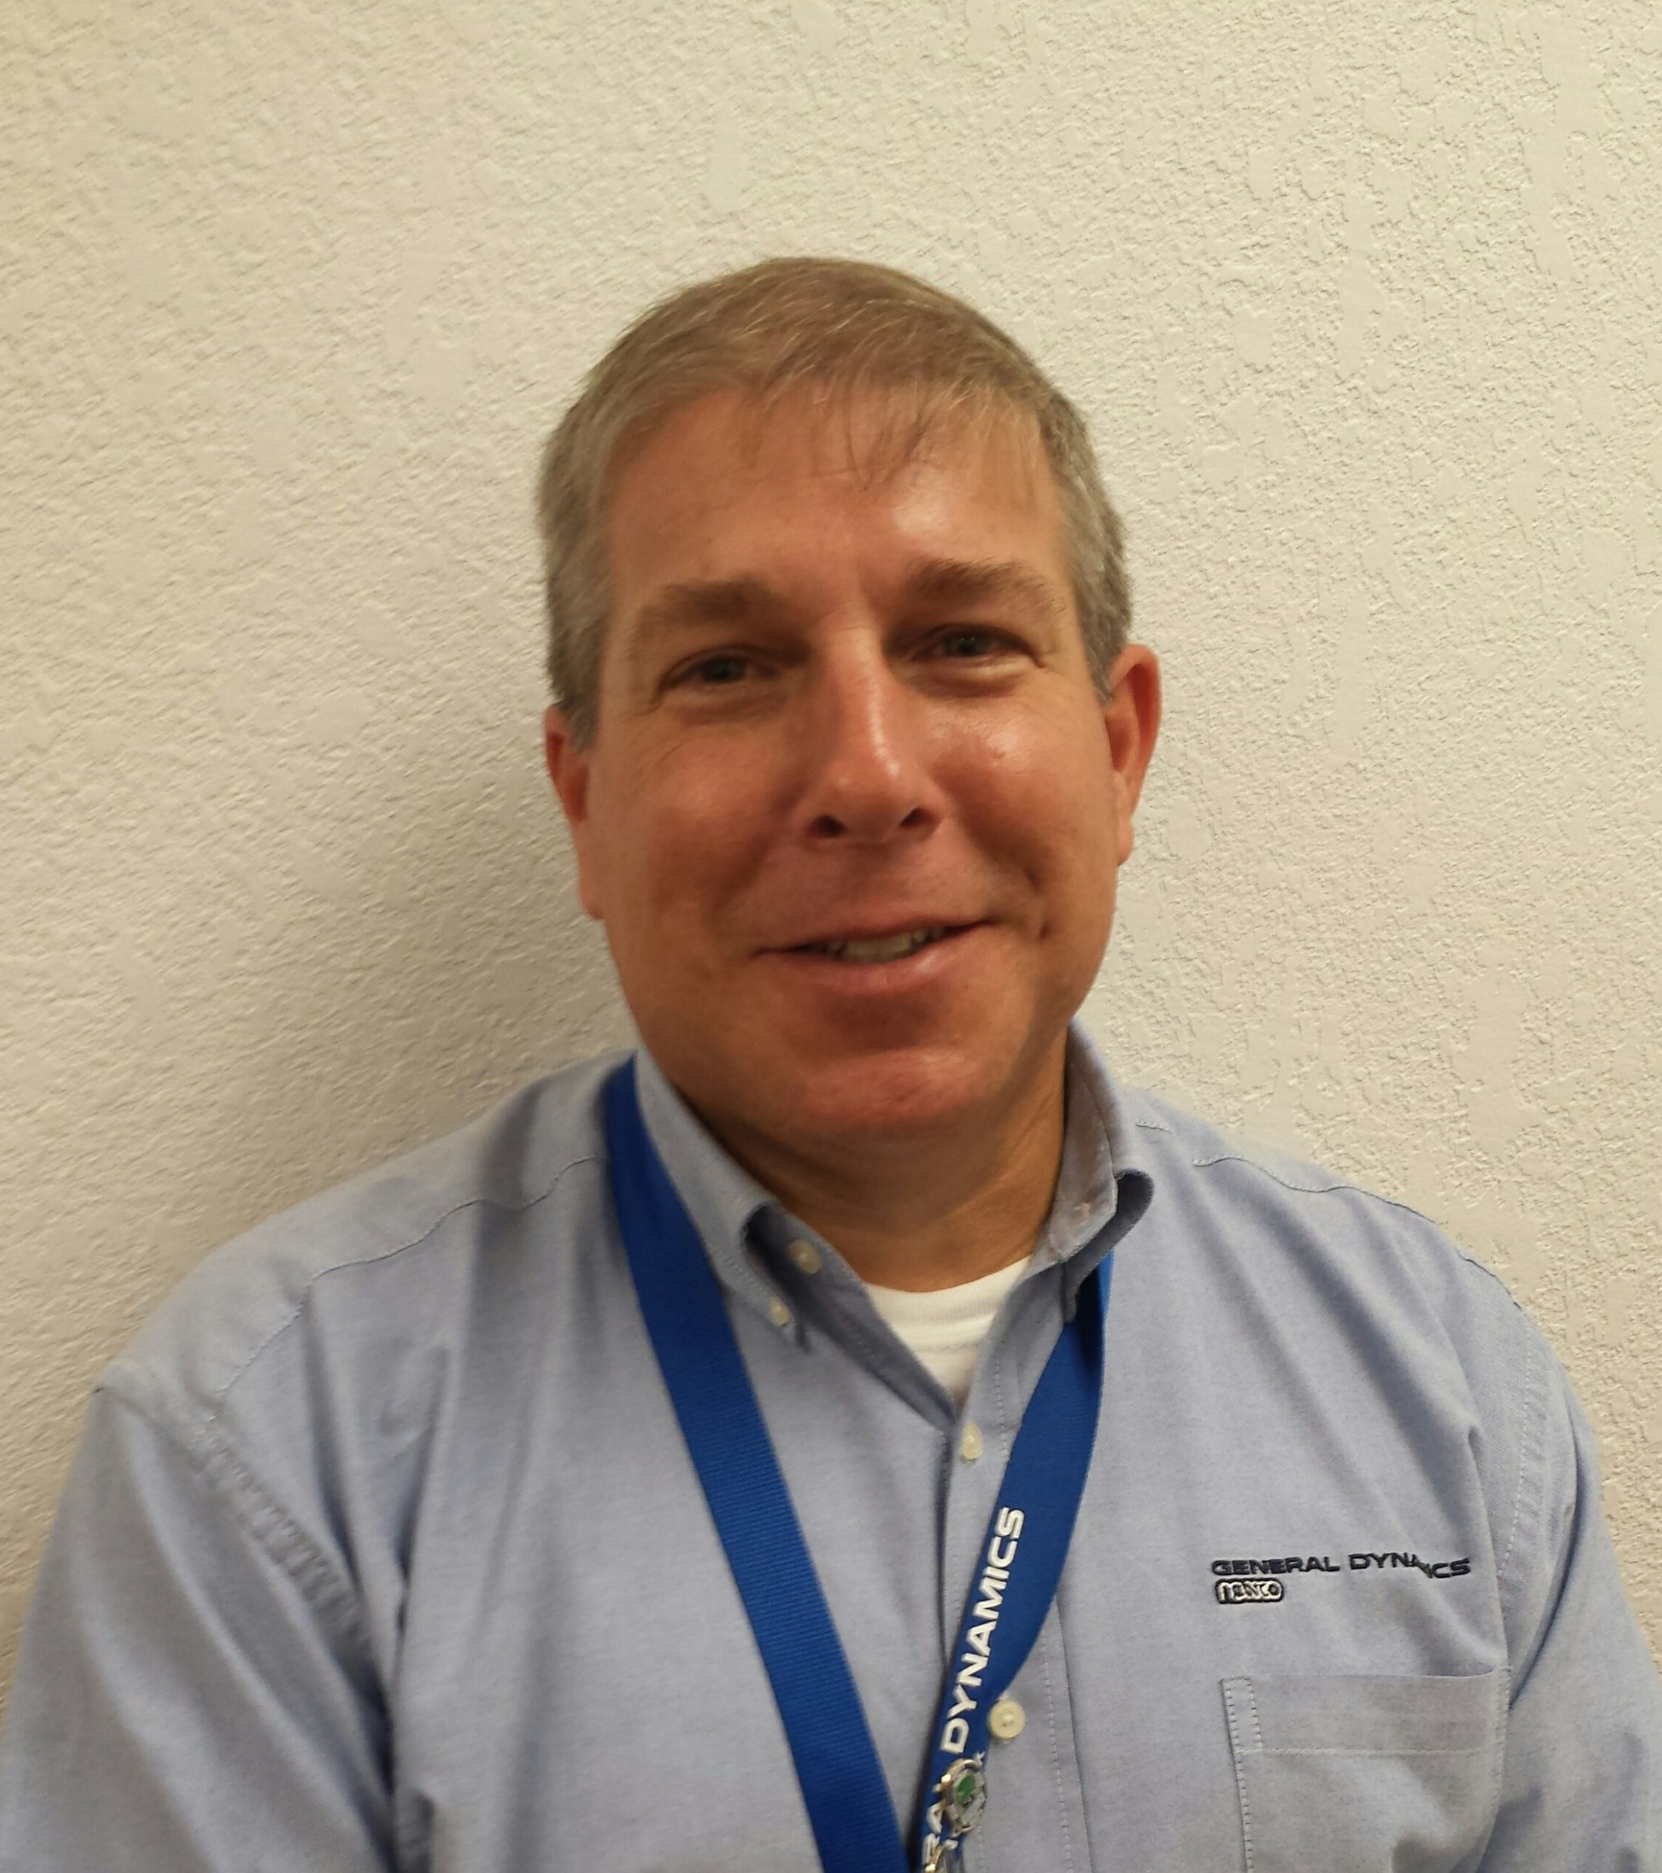
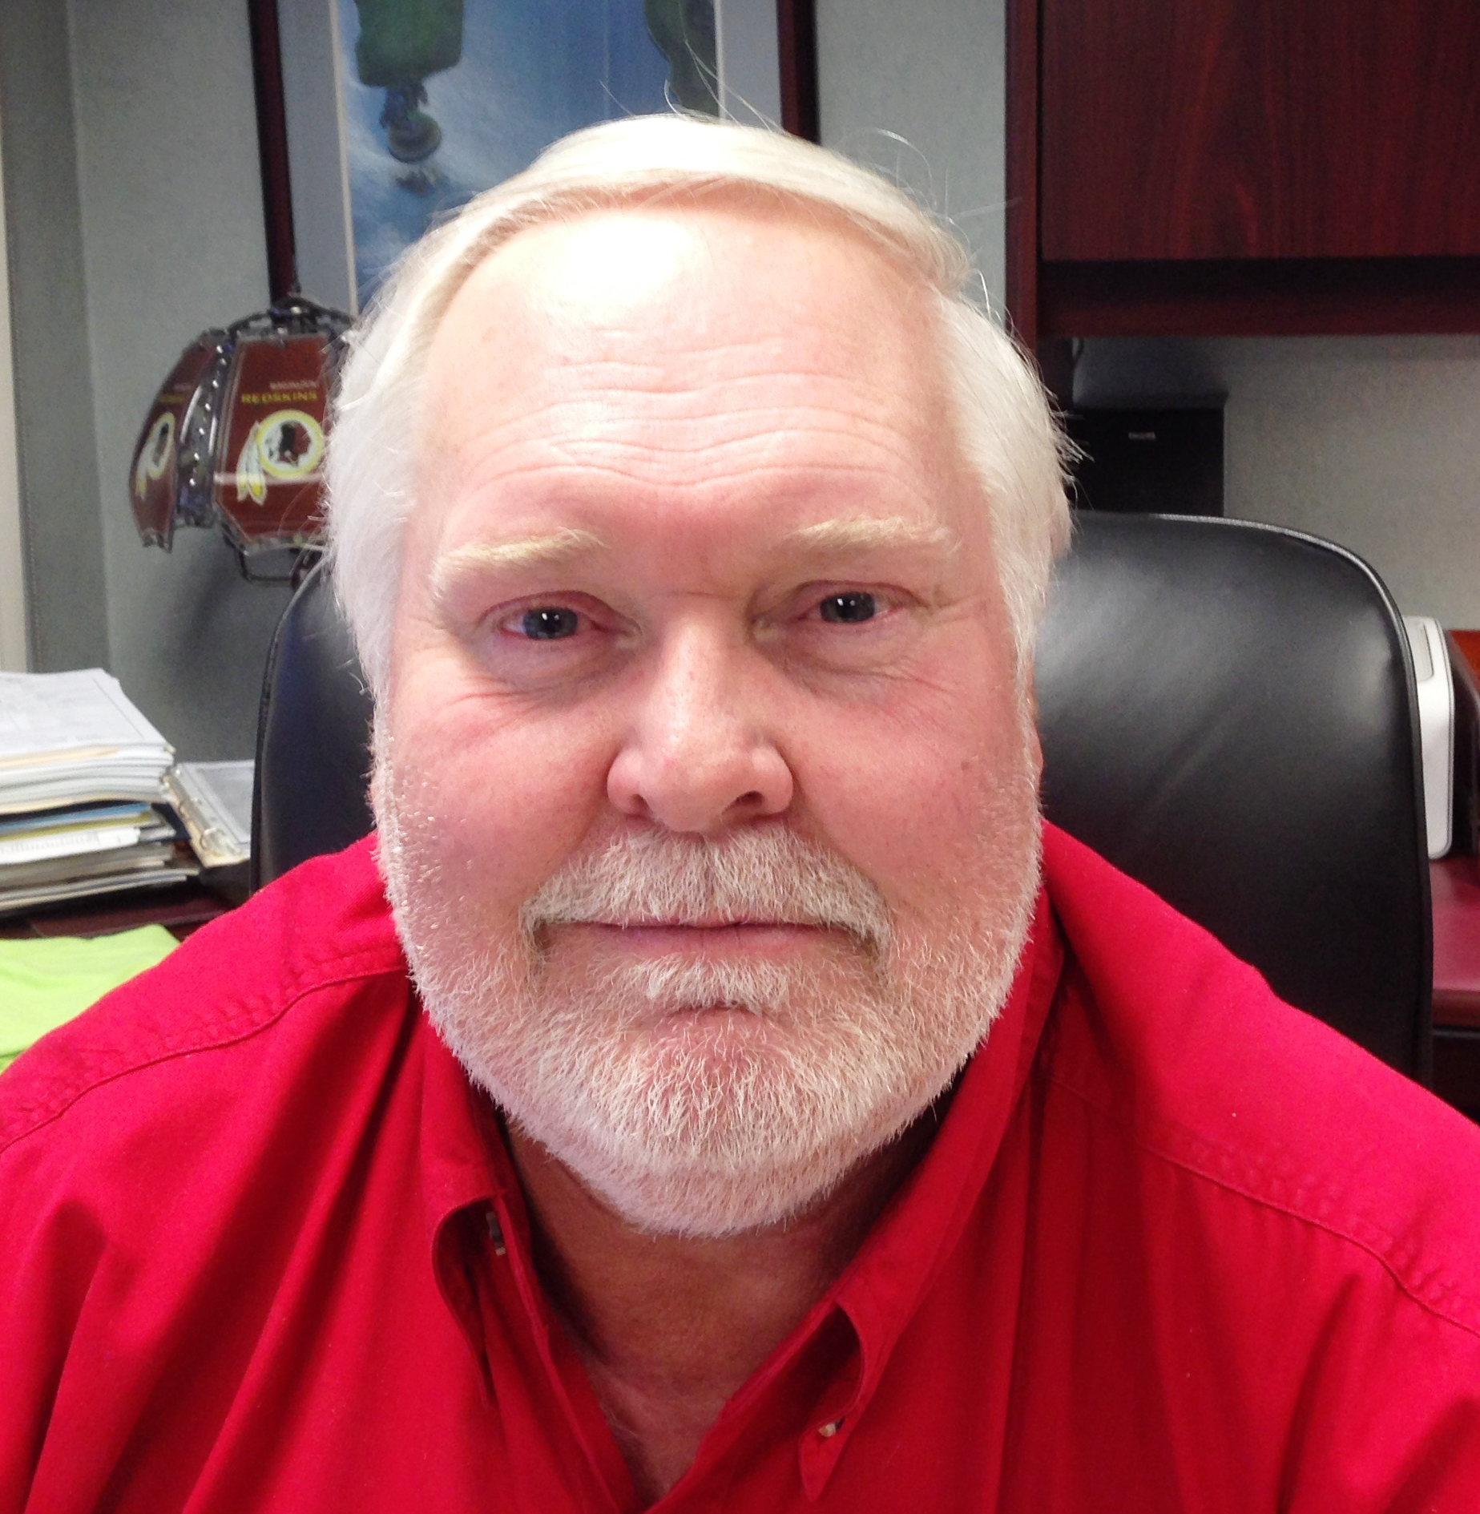
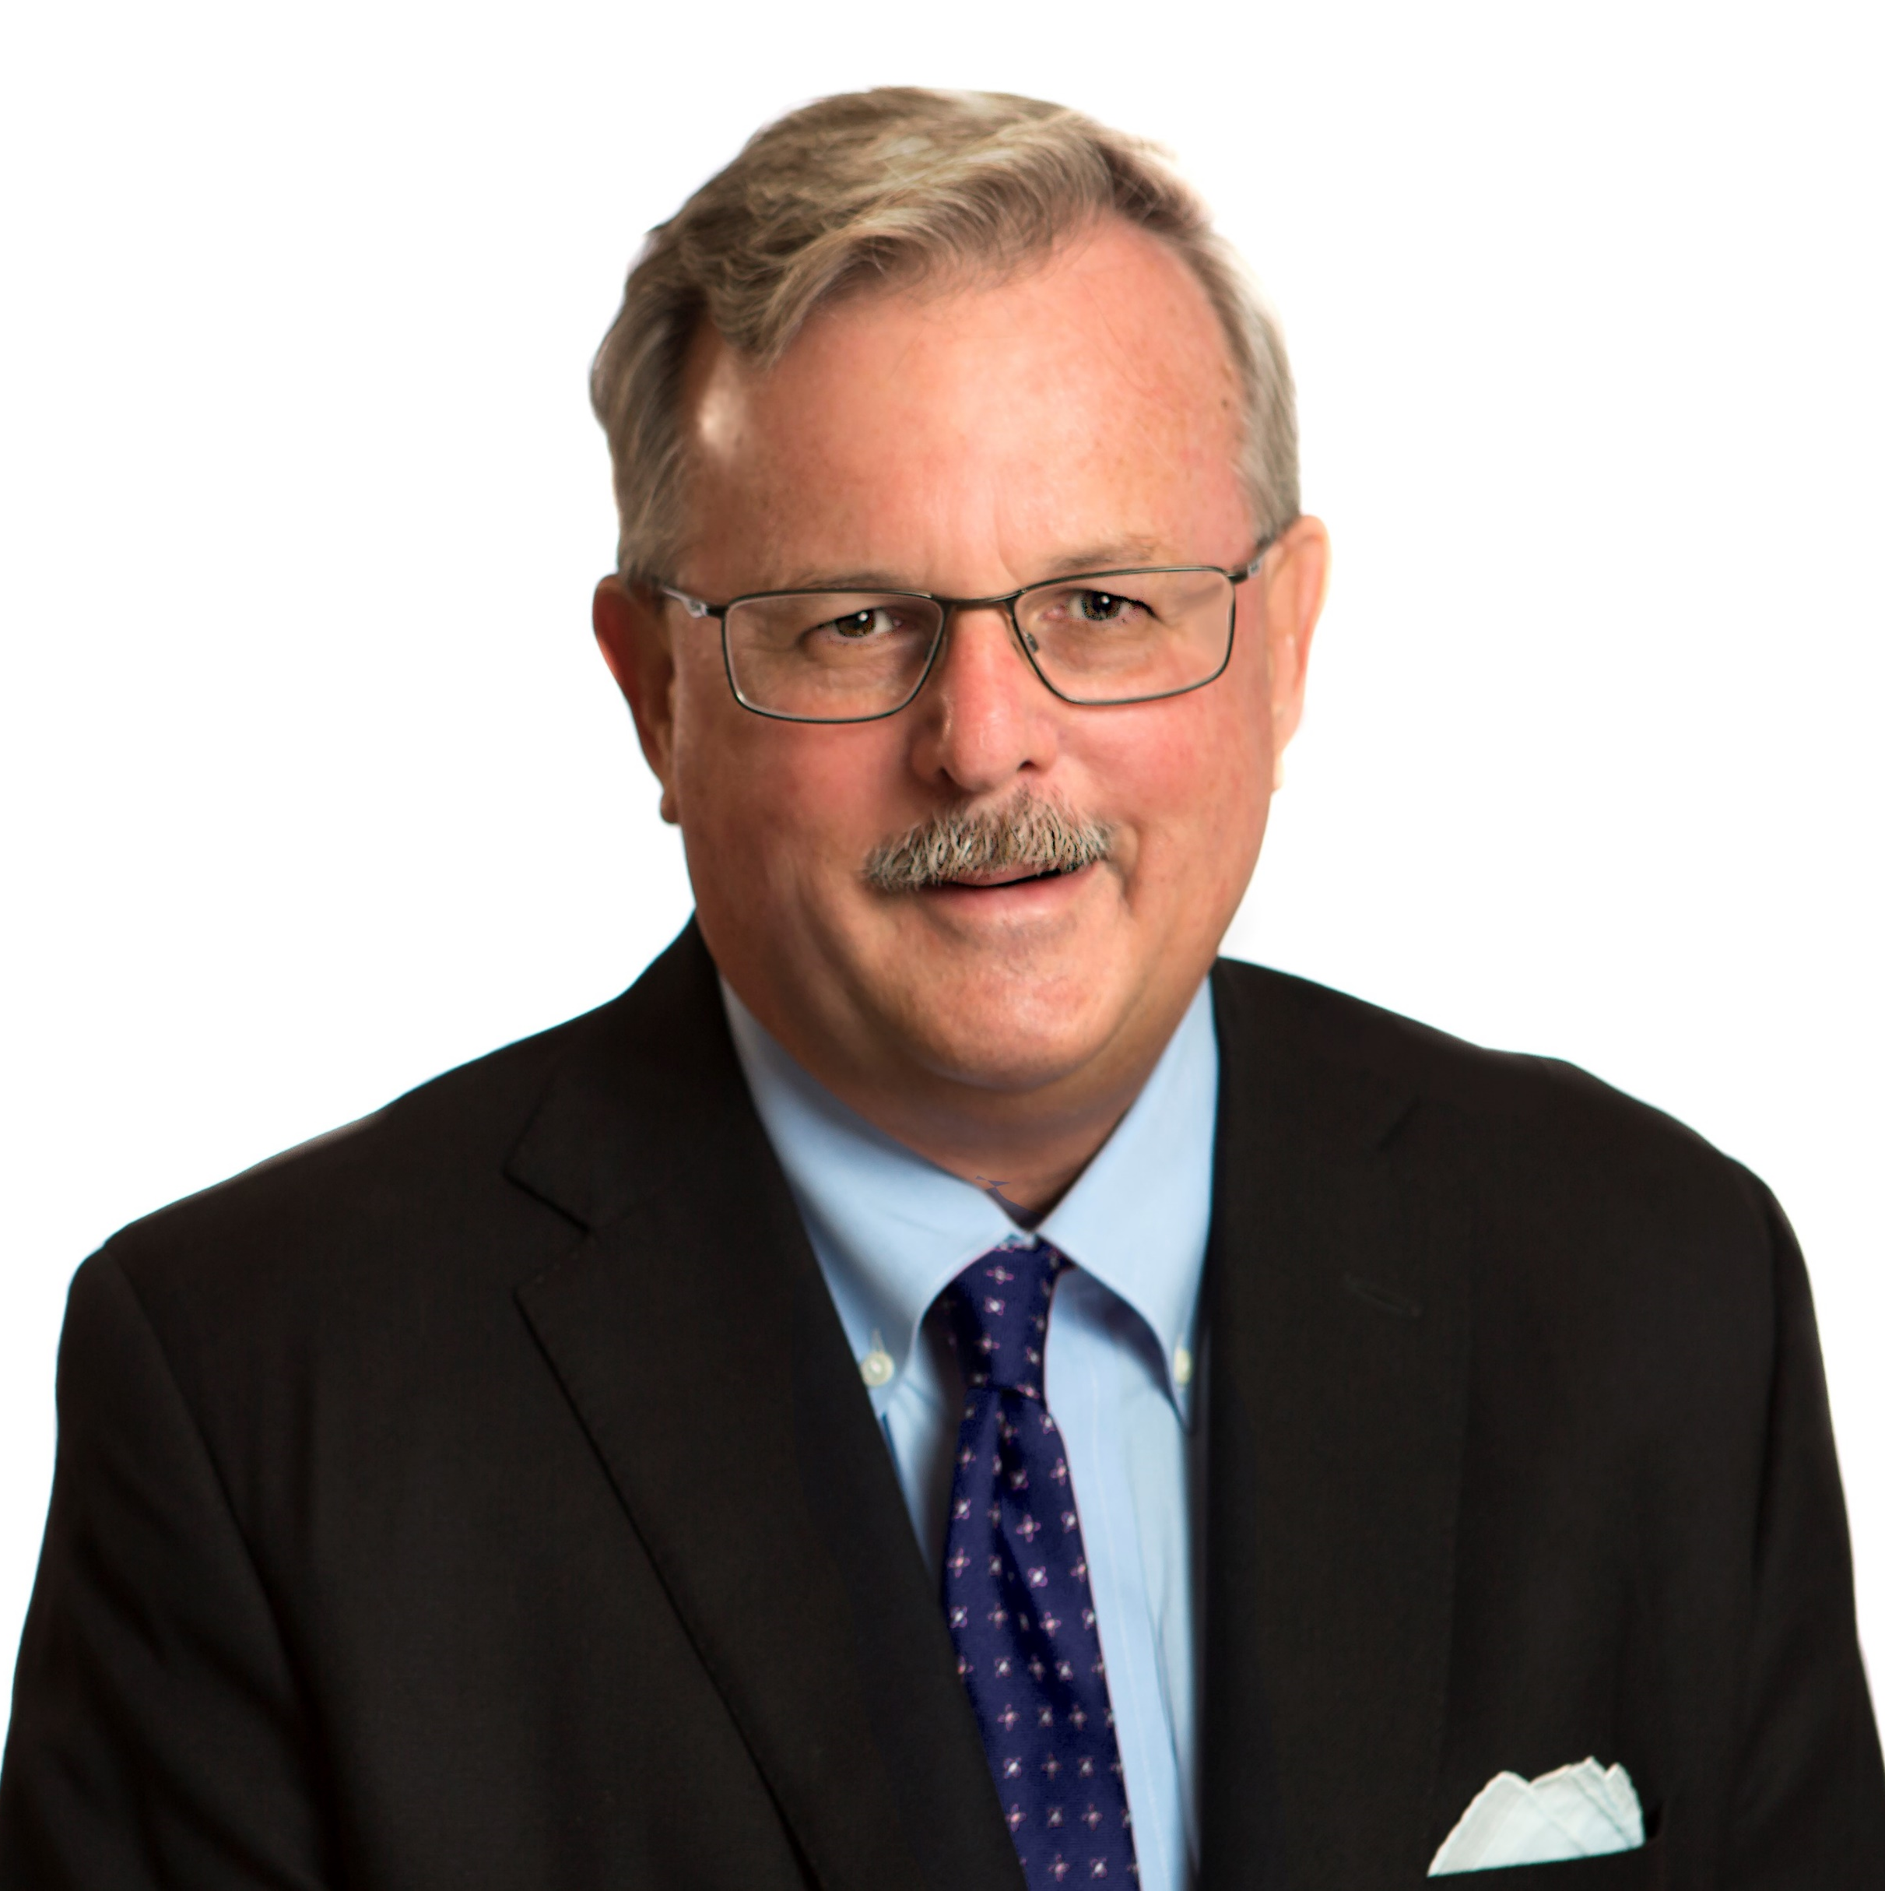

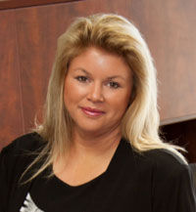
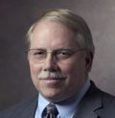
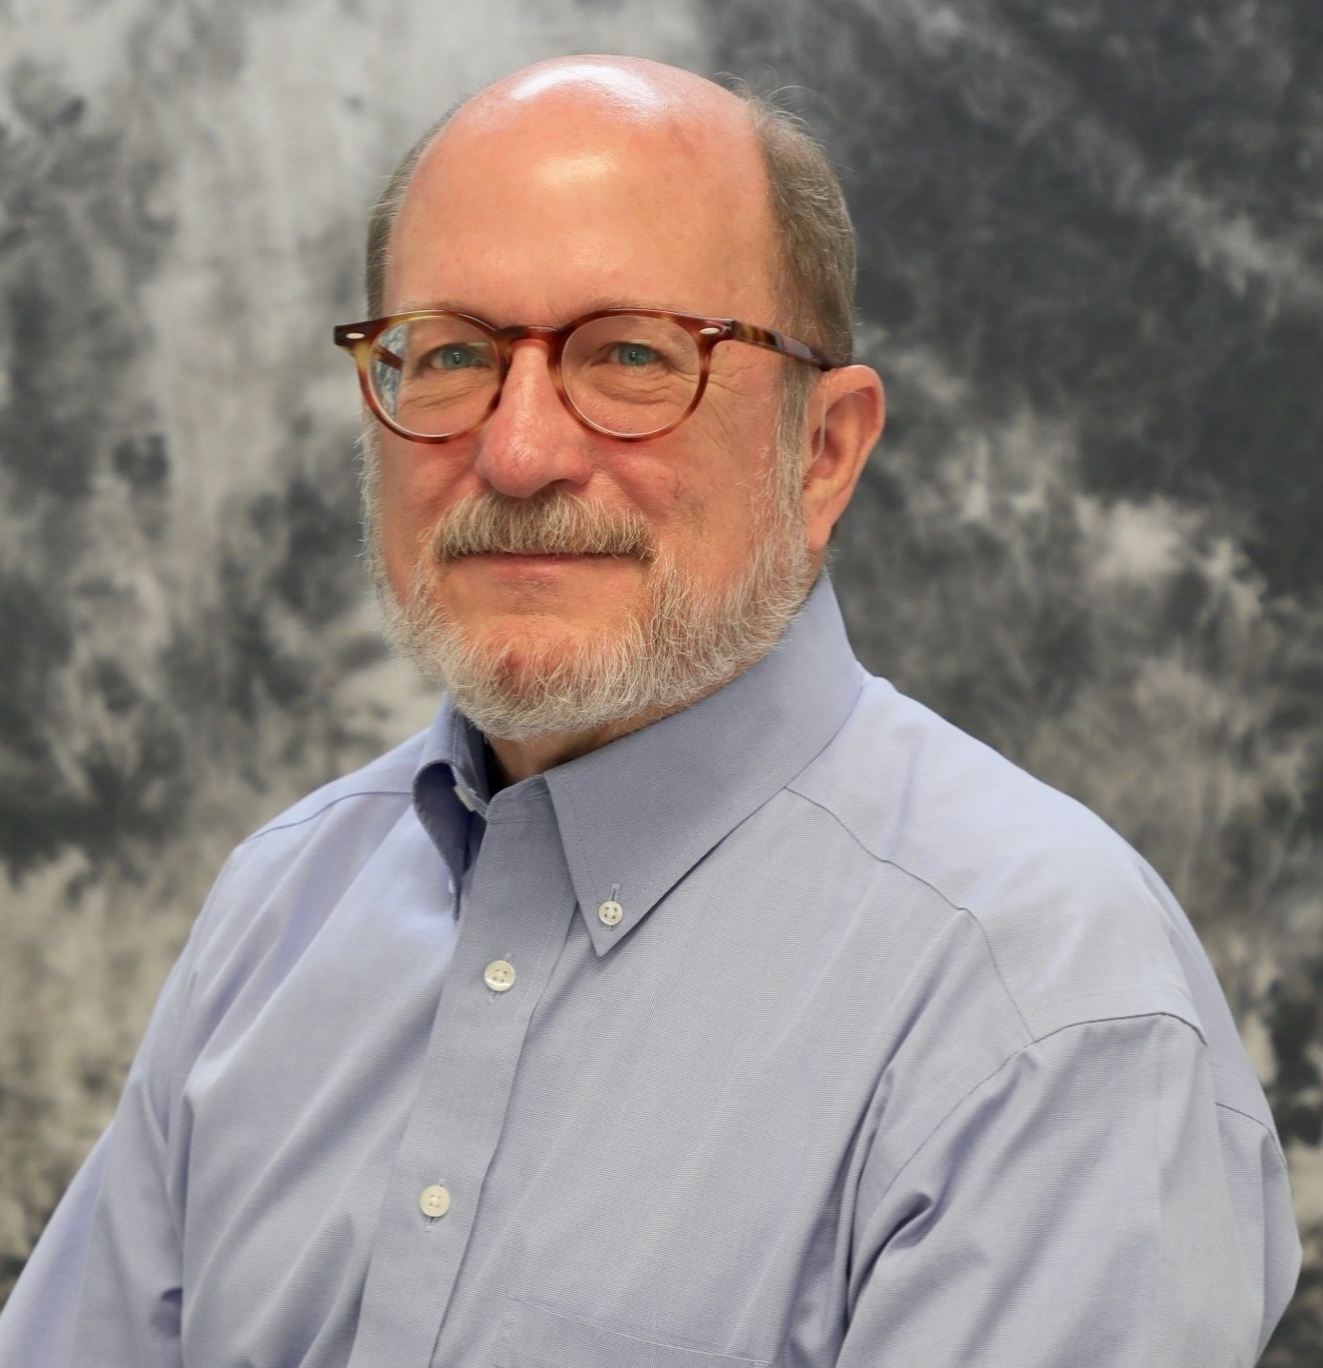
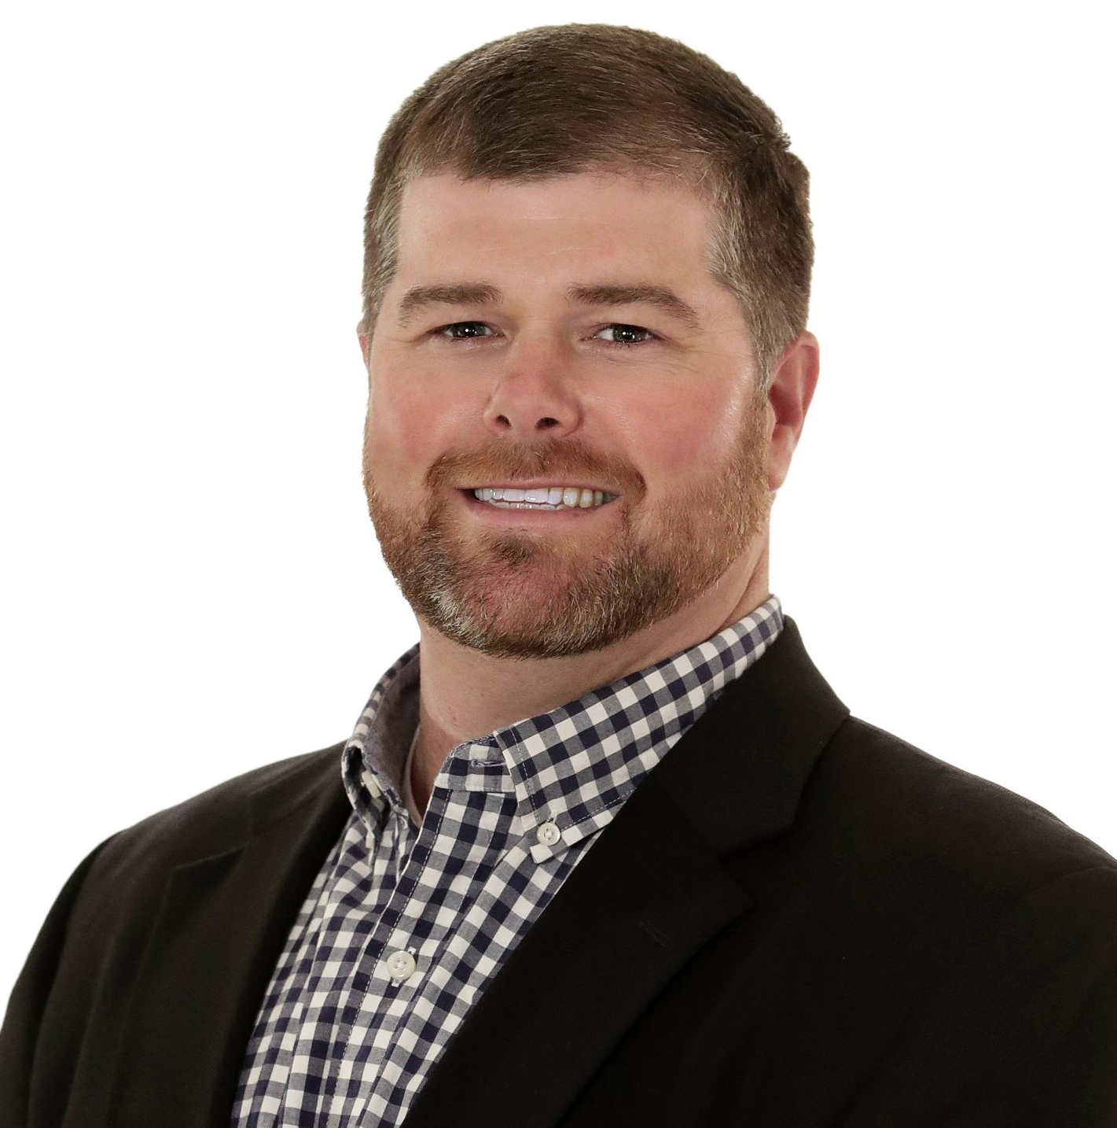
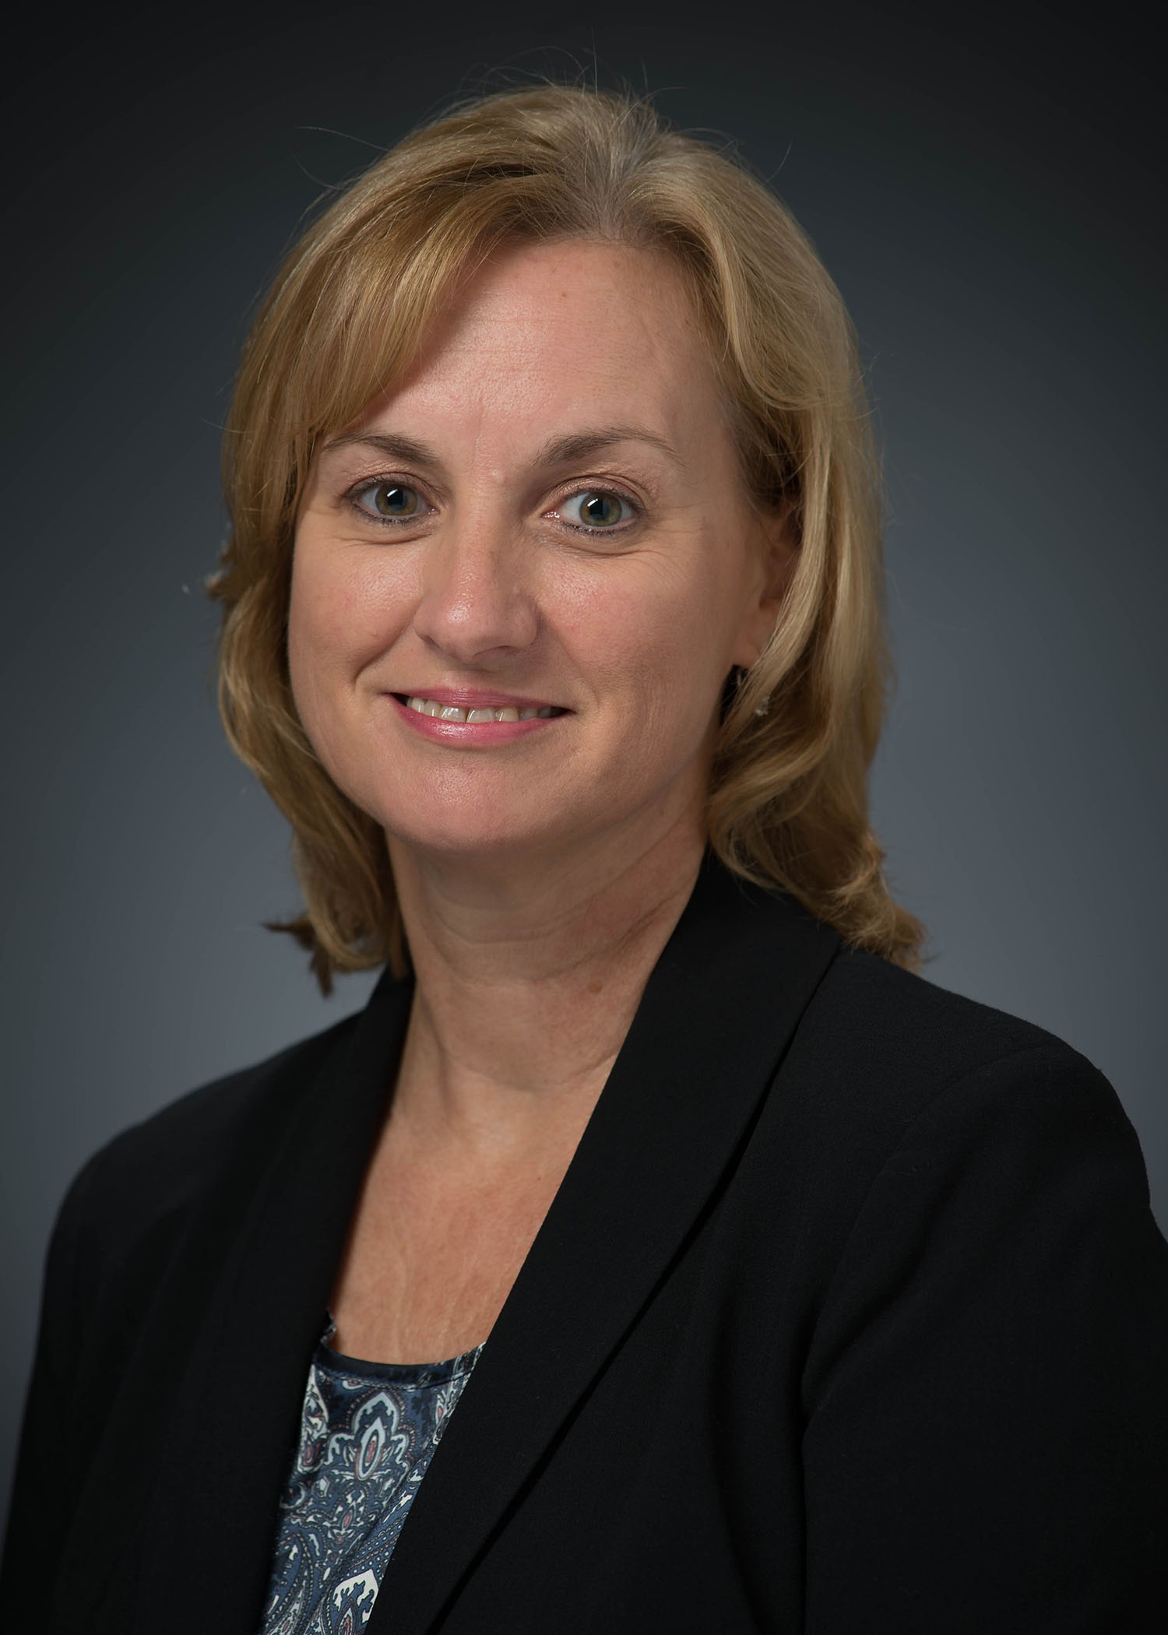
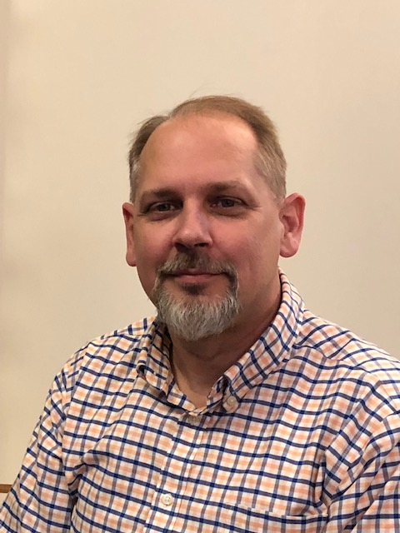
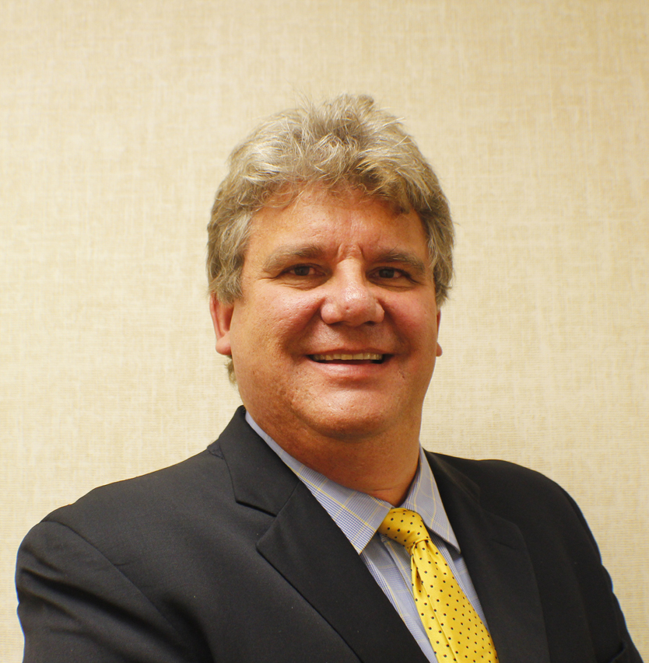
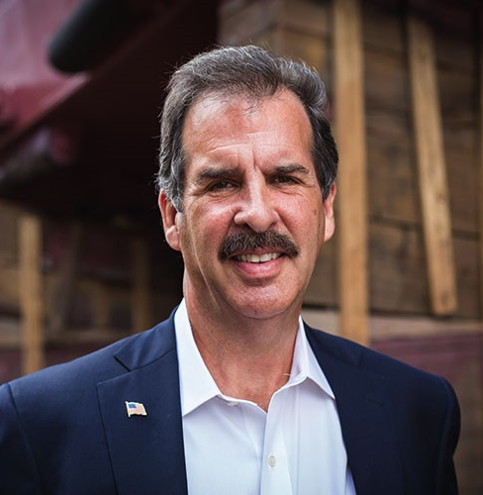
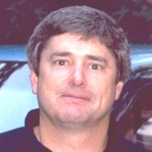
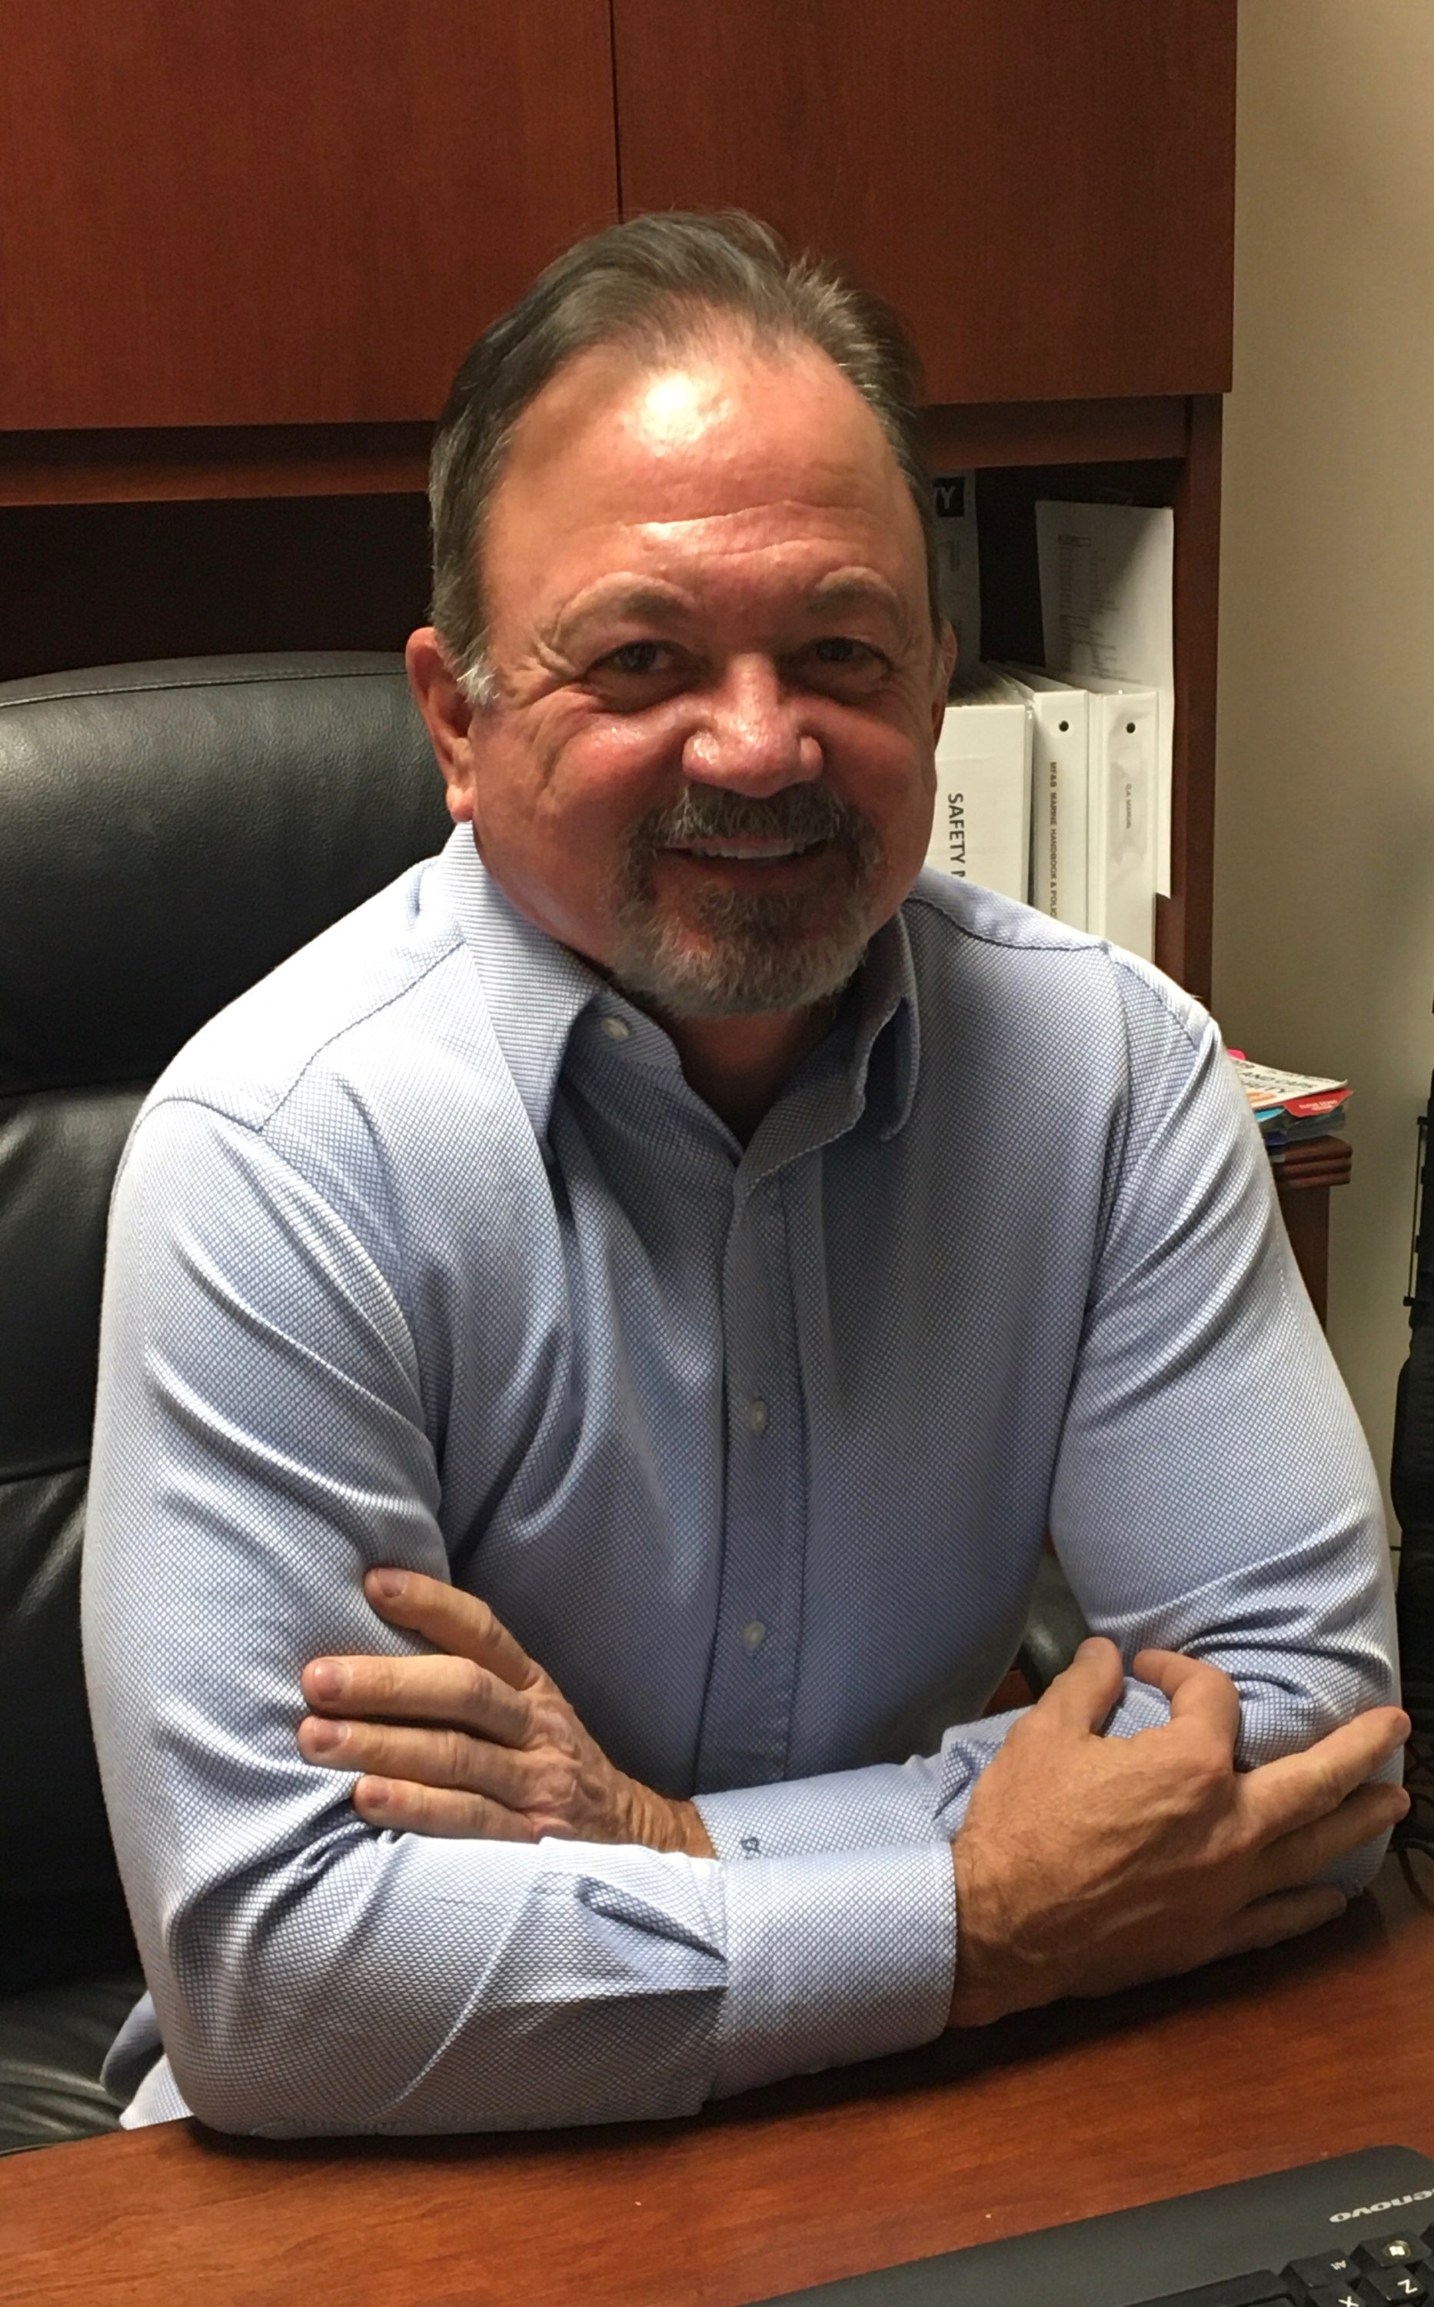
Thank you! VSRA Board of Directors

Slide 8
Thank you! Foundation Board of Directors
Robbie Walker
Dawn Angrisani
Matt Daugherty
Nikole Dunkley
Bob lynch
Trinity lefler
Shari epps
Josh guedesse
Chris murray
Tanya howard
Todd kling
Nikki nuckols
Leslie mcaloose
Jay prock
Terry stead

Slide 9
Thank you! Outgoing vsrf leadership
Dawn Angrisani
Foundation board chair, 2016 - 2020
Brian Daugherty
Foundation secretary / treasurer, 2017 - 2020

Slide 10
Thank you! Committee Chairs
Chris Abel
Kathy bryan
Tracy Gregorio
Tony Mazzeo
Tom binner
Dan terry
Donna Watkins
Karen miller
Tim richardt
Leigh kennedy
Neil burns
Jeff hanson
Mark Salladay

Slide 11
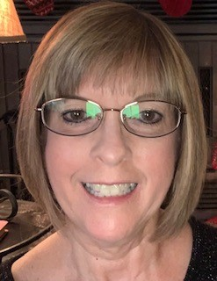
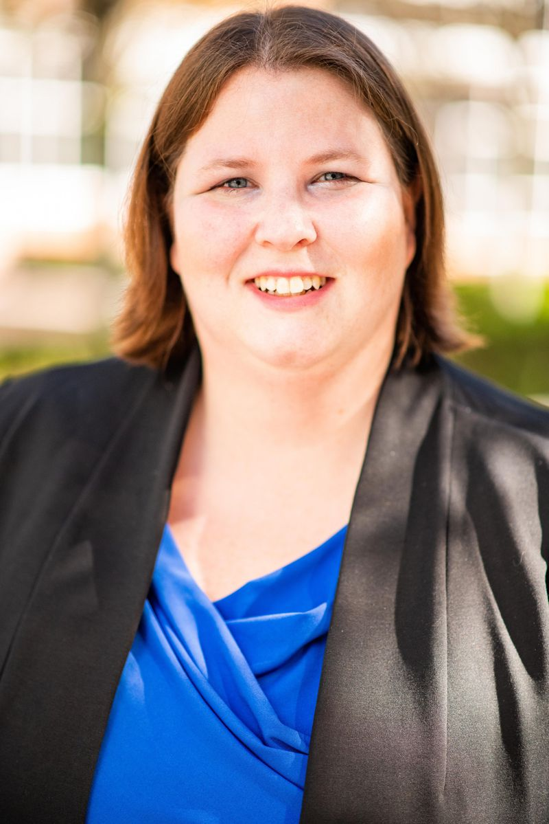
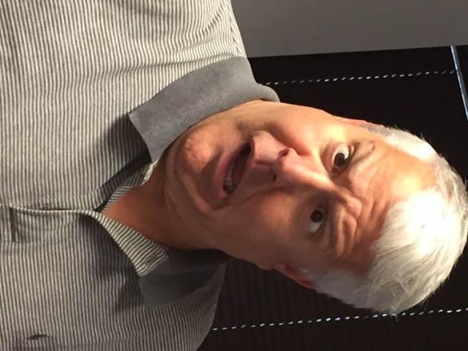
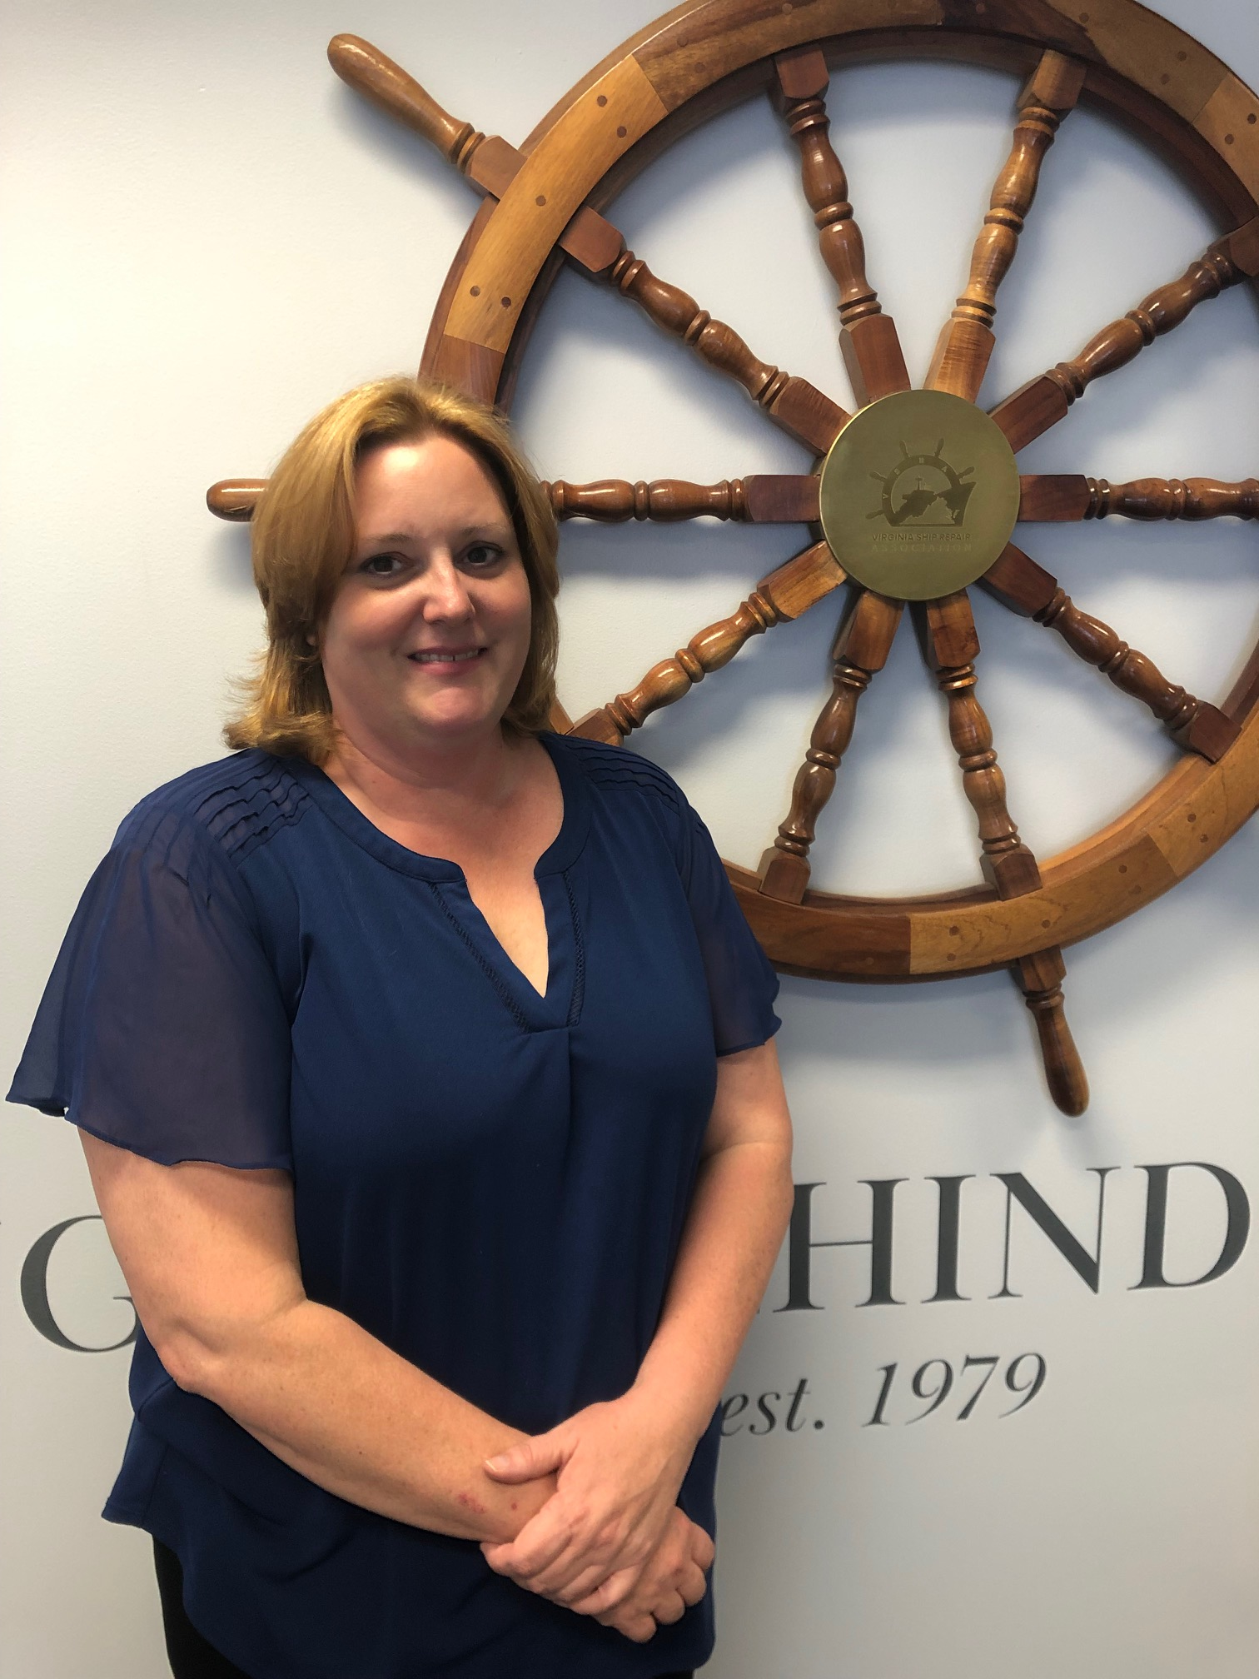
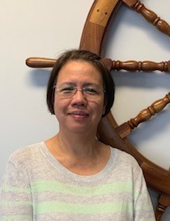
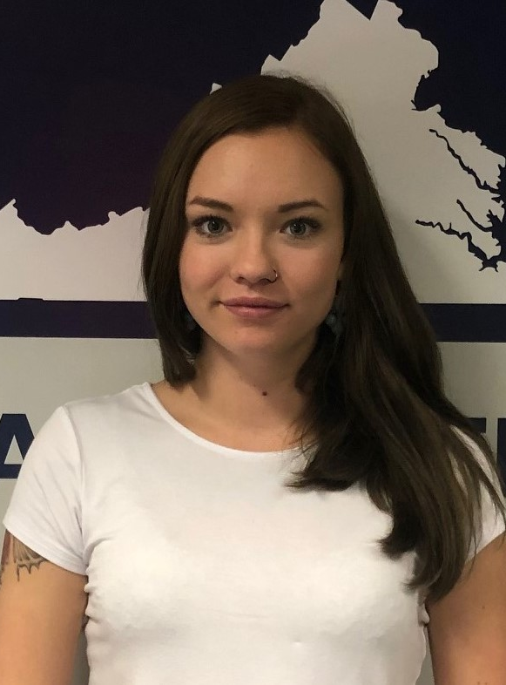
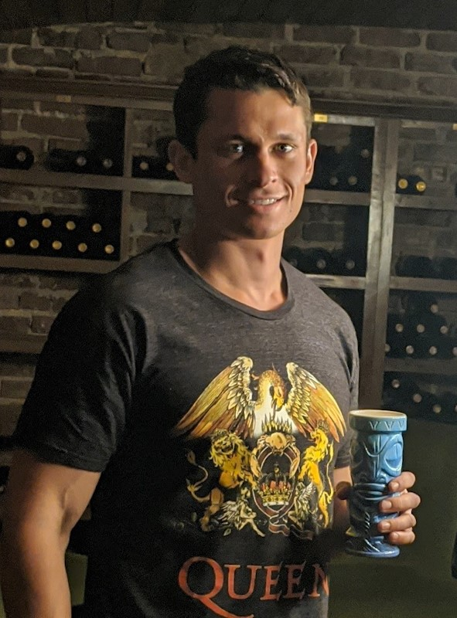
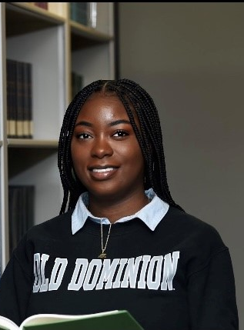
Thank you! Association Staff

Slide 12
A major milestone:
303 VSRA Members

Slide 13
A major milestone:
303 VSRA Members
Thank you!

Slide 14
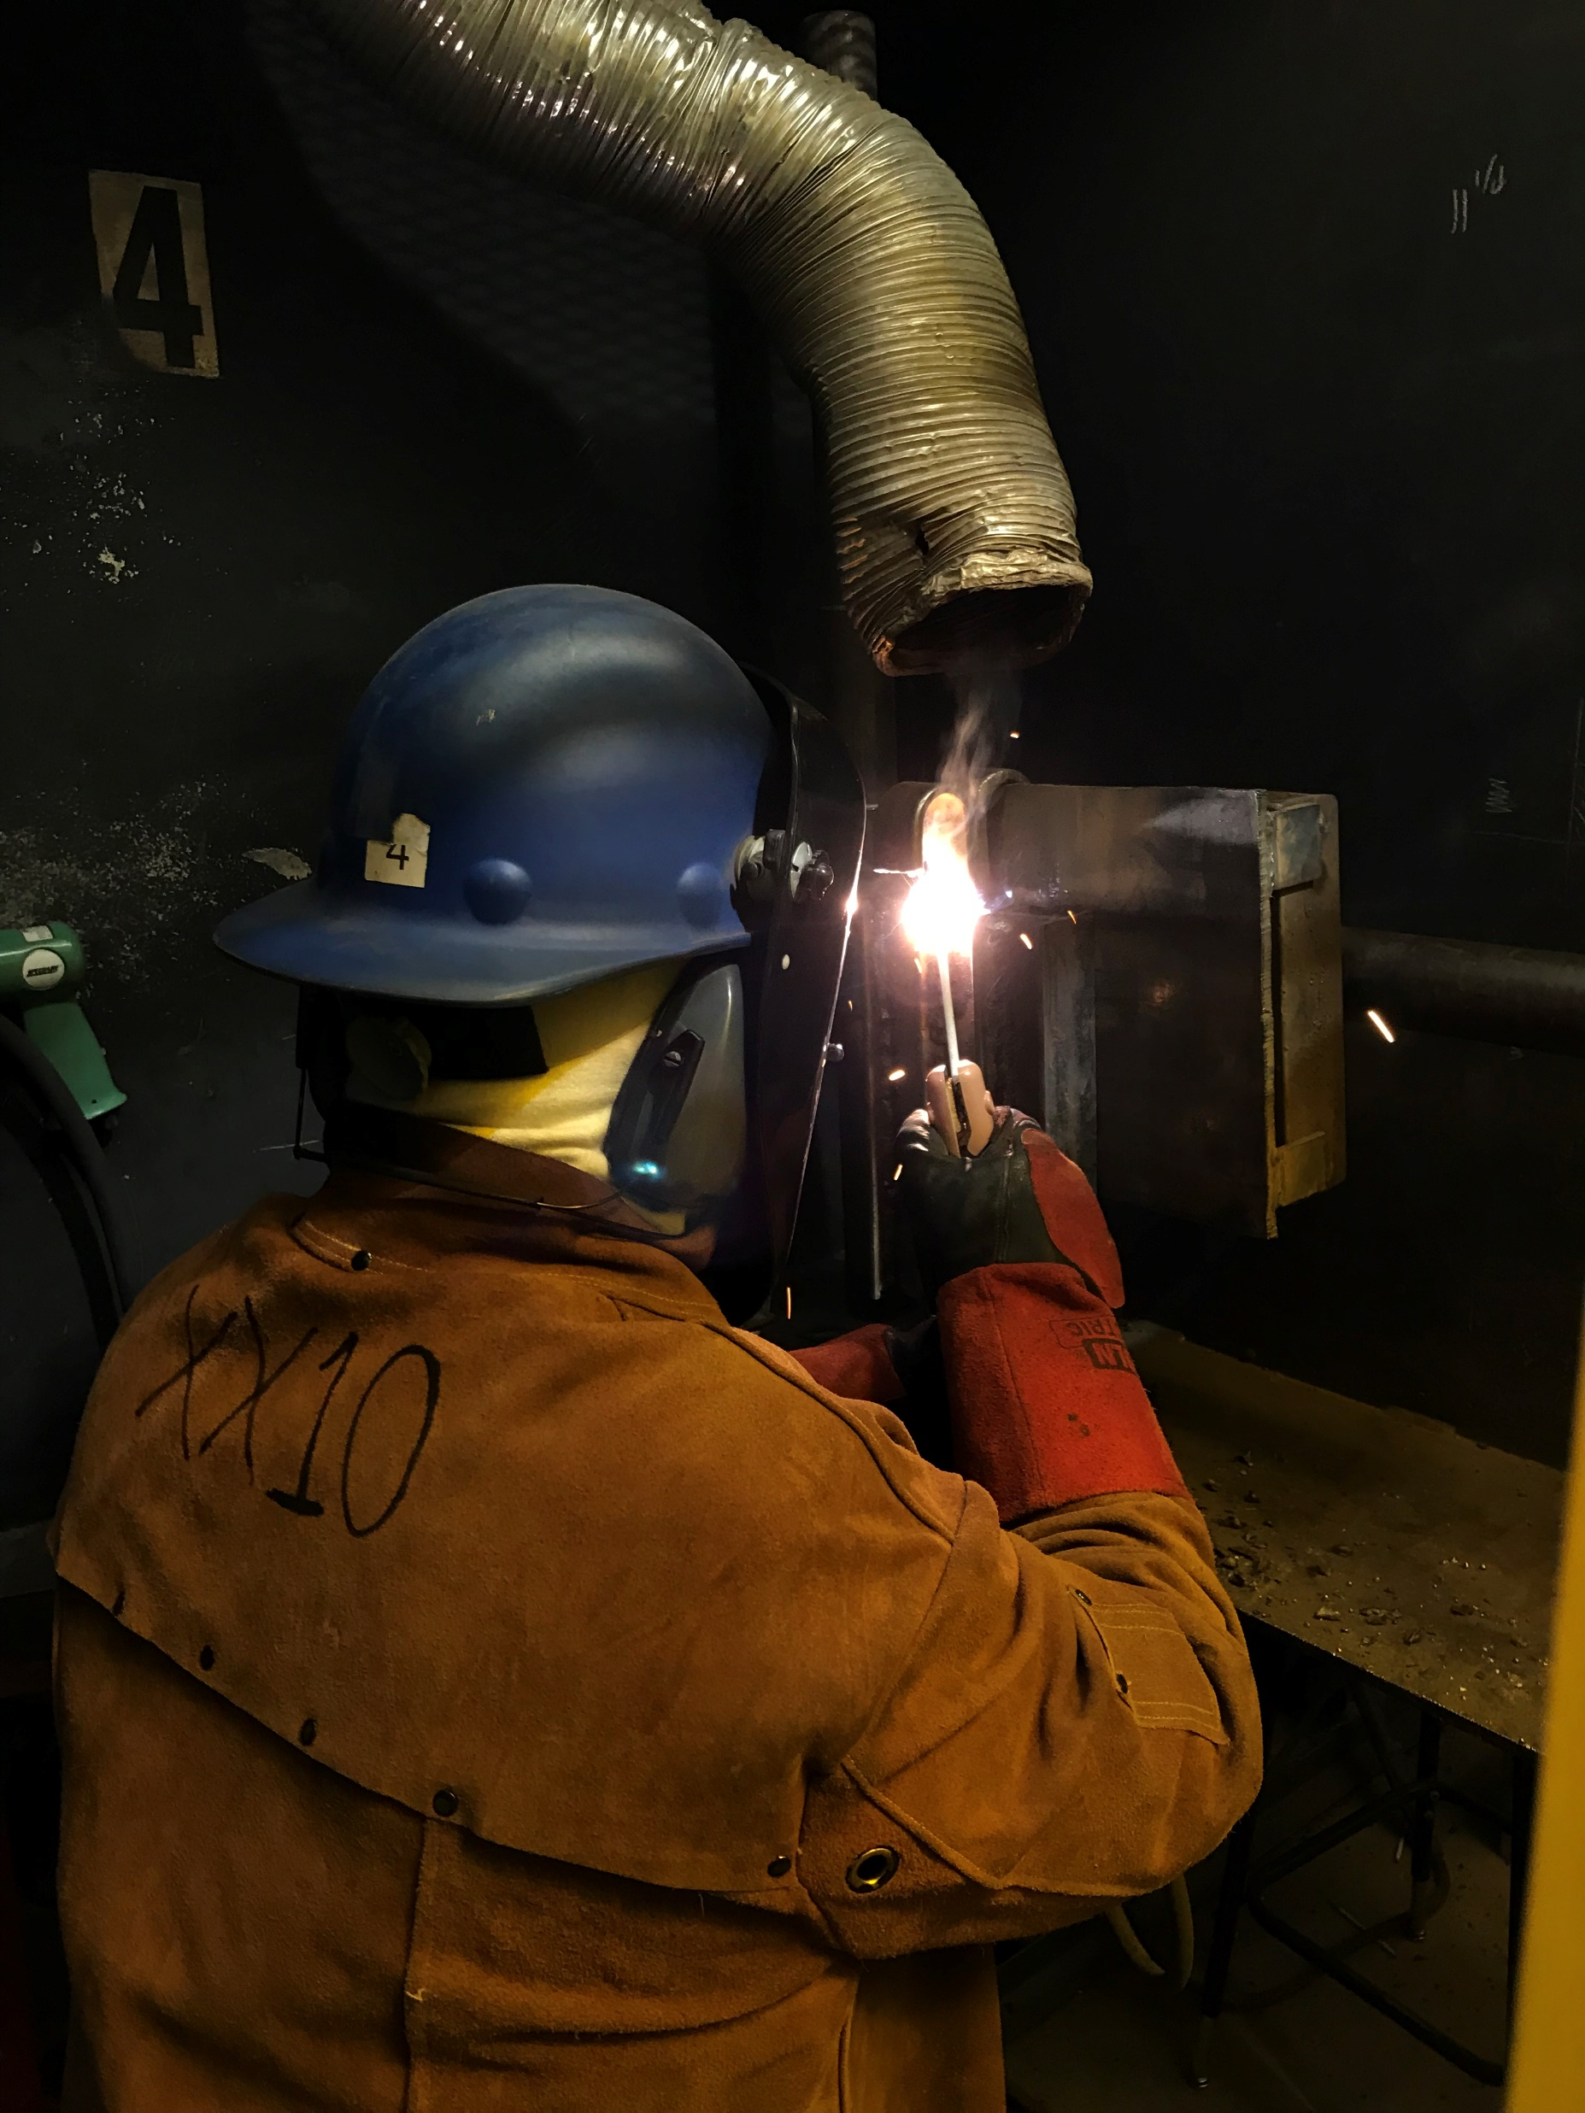

Resilience. Perseverance. Grit.
Determination. Pride.
Patriotism.
words that defined ship repair in 2020

Slide 15
The world faced a global health crisis. You faced it head on.
Safety Committee Best Practices / Resources Guide.
Quickly adapted to virtual Committee meetings.
Contracts Committee CARES Act Webinar.
HR & Safety Committee Joint Webinar.

Slide 16
The world faced a global health crisis. You faced it head on.
Launched & Maintained Workforce Development Committee.
Expeditiously resumed training and ensured safe learning spaces.
Established VSRA / Navy solutions-driven working groups.

Slide 17
Virginia Ship Repair Foundation a record-shattering year.
VSRF Golf Tournament: most funds raised in 34-year history.
LEGO competition: 26 schools registered to compete.
Tradesperson of the Year: 31 nominees, more than ever before.

Slide 18
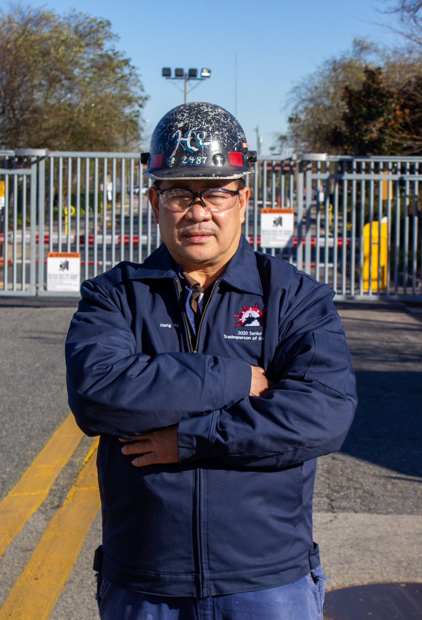
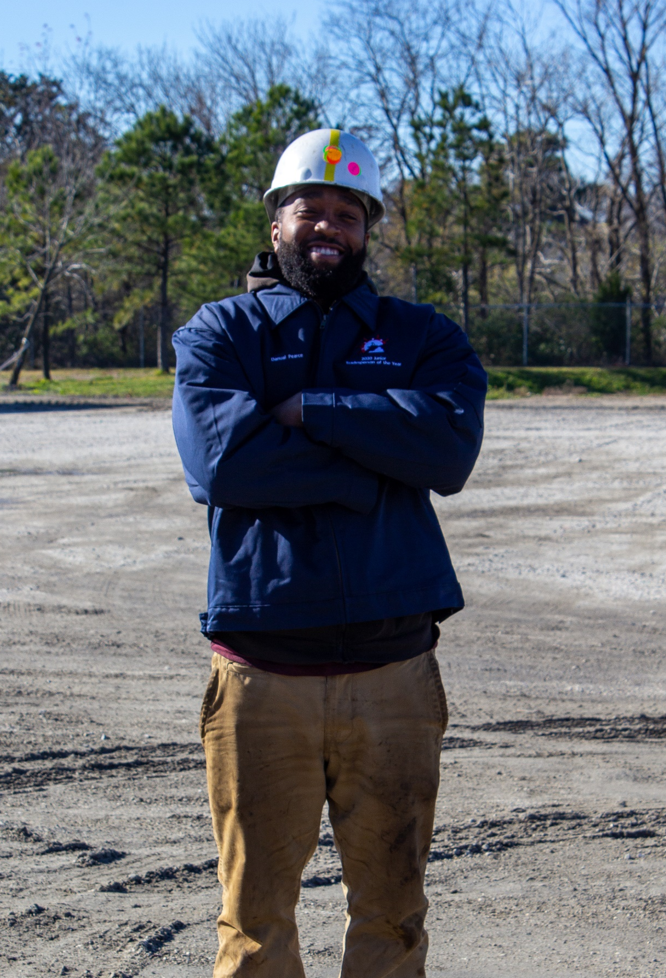
Tradesperson of the year award winners.
Heng Hy
Senior award winner
Danual pearce
Junior award winner

Slide 19
Virginia Ship Repair Foundation women in skilled careers.
Successfully graduated 4 classes.
Thank you to those who provided industry tours and guest speakers.
Successful partnership with many community and educational groups.

Slide 20
2021

Slide 21
: Looking ahead.
There are many unknowns...
… but Ship Repair will continue to persevere!
2021

Slide 22
Looking ahead.
Strategic goals of your association.
Advocate to maintain and strengthen the capability and capacity of the industrial base.
Increase awareness of and support for the Hampton Roads ship repair industry.
Attract new workers to meet current and future industry demands.
Enhance the skill and knowledge level of the current and future ship repair workforce.
Provide maximum Member value and return on investment.

Slide 23
Looking ahead: Advocate.
Strengthen navy partnerships.
NAVSEA Standard Items.
Contracting Concerns & On-Time Delivery.
VSRA representatives leading the way!

Slide 24
Looking ahead: awareness.
Increase support of the industry.
Continued media campaigns.
New “My Ship Repair Story” testimonial videos.
Strengthen federal, state, regional, and community partnerships.

Slide 25
Looking ahead: attract.
meet industry workforce demands.
VSRF initiatives to continue full speed.
Launch Wage Survey in February.
Virtual LEGO Competition in April.
Golf Tournament registration to open soon.

Slide 26
Looking ahead: enhance.
Train current and future workers.
Updated Spanish Safety Orientation.
Upgrade Online Training technology.
Review current Marine Trade Training and develop new career pathway programs.

Slide 27
Looking ahead: provide.
Maximize Membership value and roi.
All virtual meetings in Q1.
Virtual committee meeting attendance option available going forward.
February Membership Meeting – Offshore Wind Opportunities.

Slide 28
Looking ahead: serve.
our ultimate objective.
Serving those who MAKE SHIP HAPPEN.
Please tell us how we can serve you better!

Slide 29
Thank you!
You don’t just talk SHIP…
… you MAKE SHIP HAPPEN!

Slide 30
PROUD.
PATRIOTIC.
PASSIONATE.
PRODUCTIVE.

